Slide 1
Pertemuan 2

Slide 2
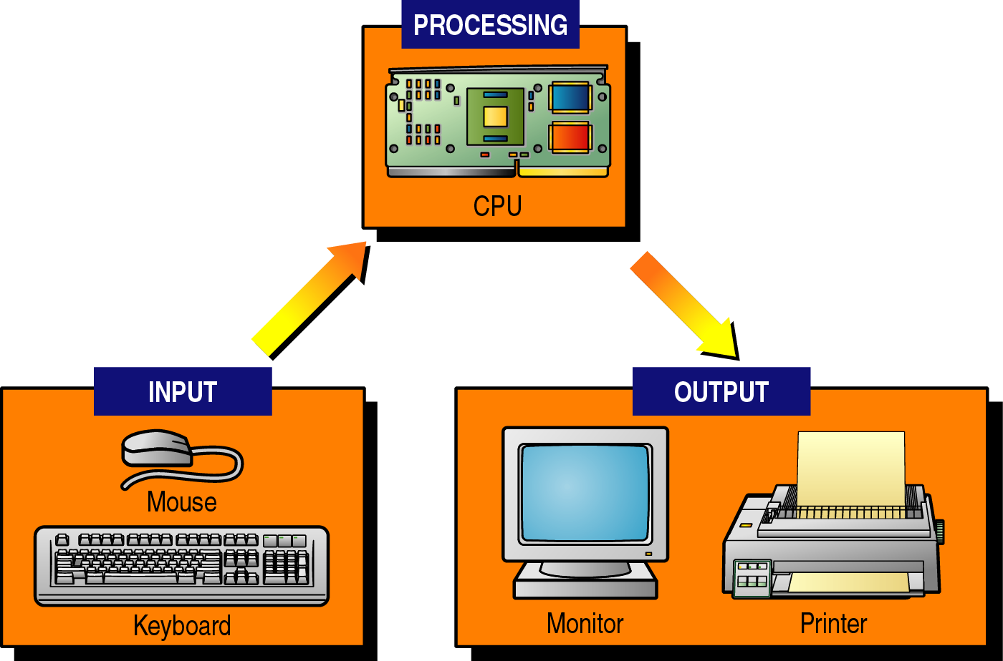
Fungsi dasar komputer

Slide 3
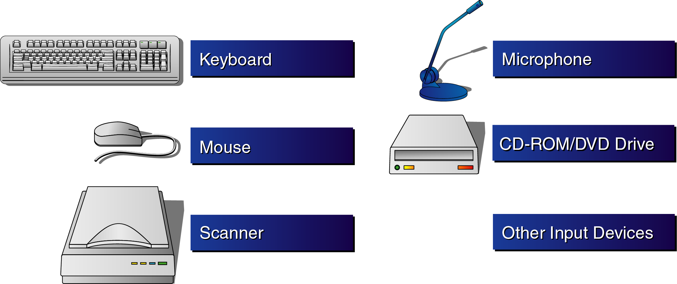
Input

Slide 4
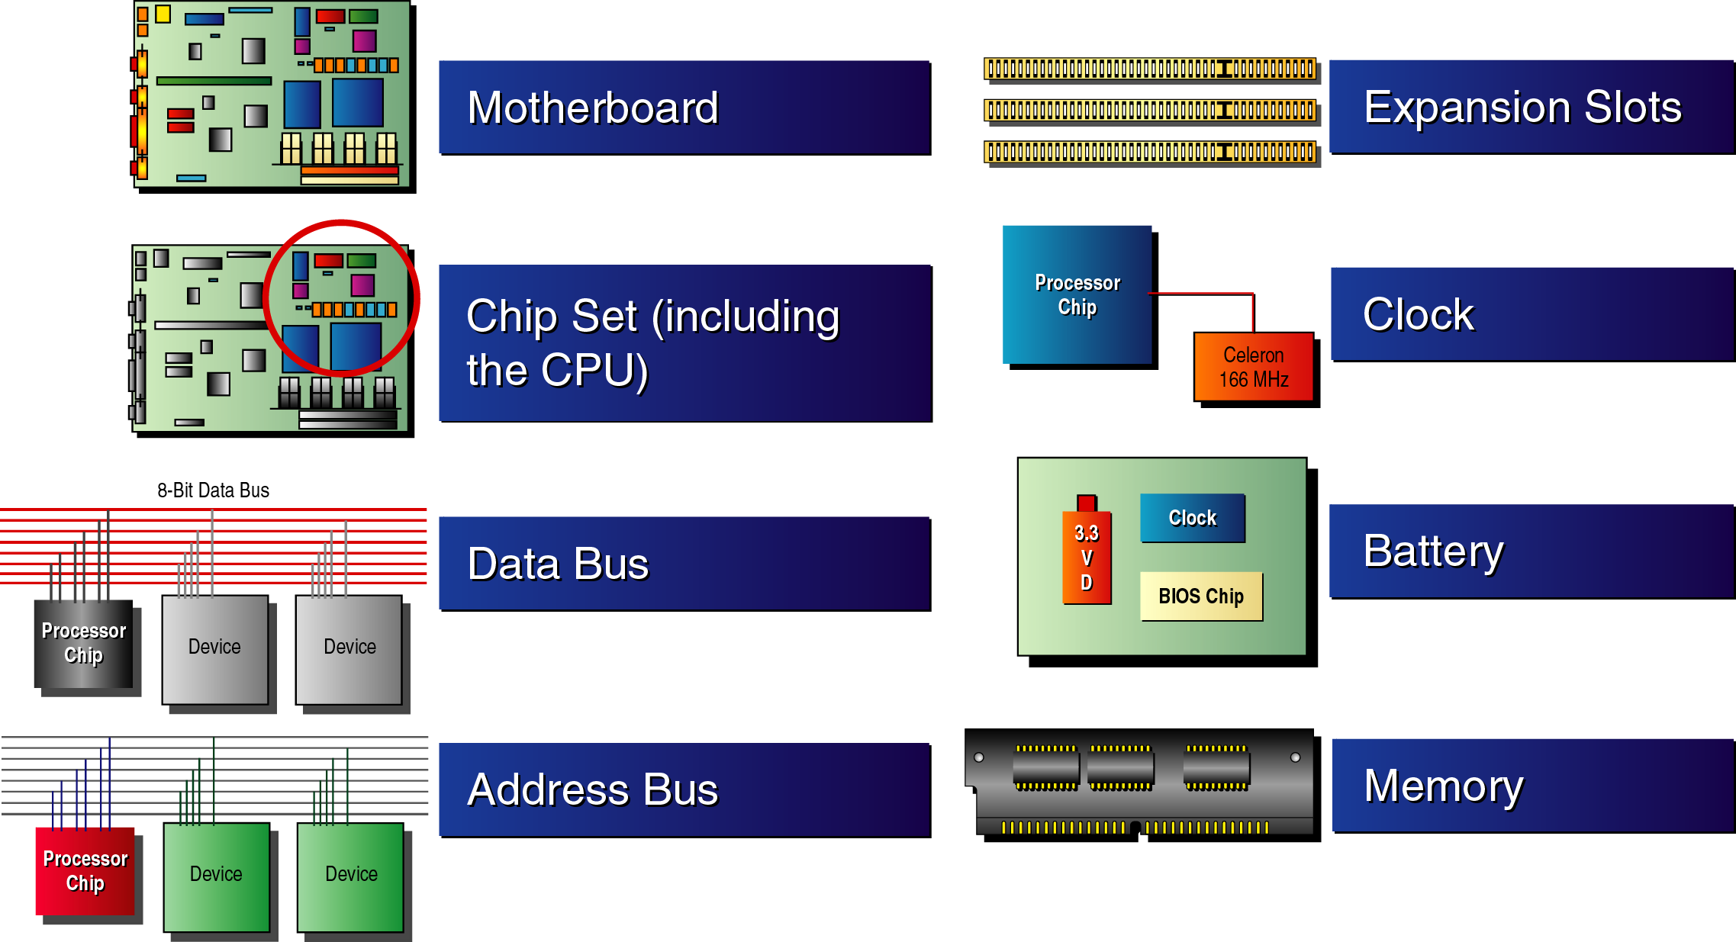
Processing

Slide 5
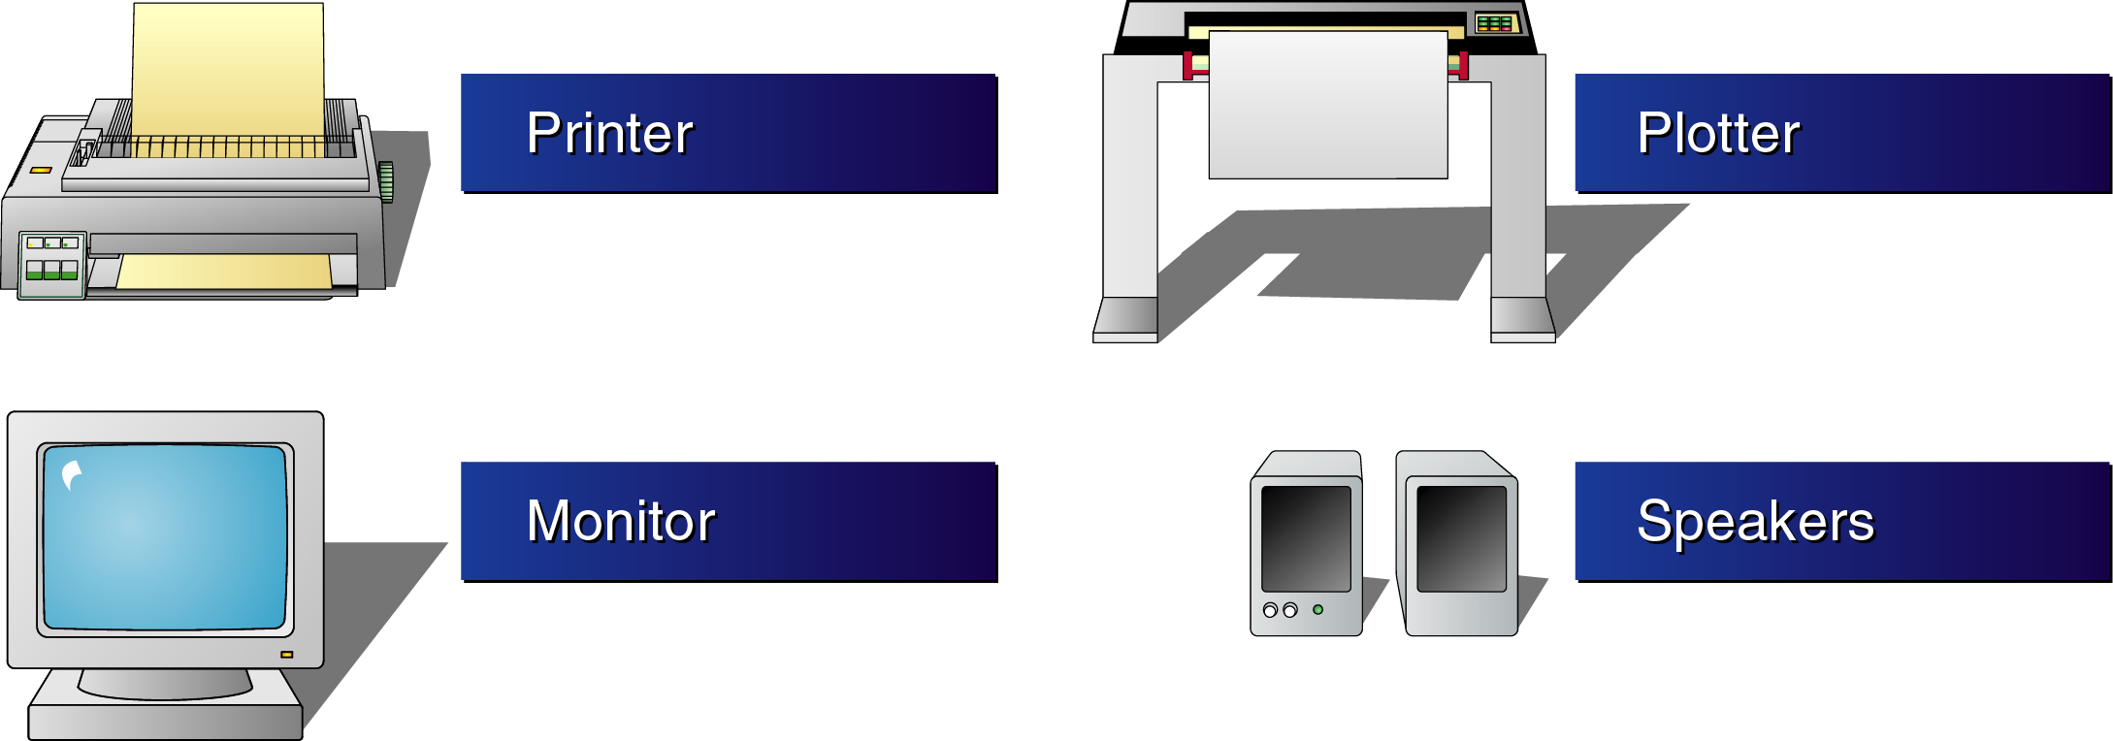
Output

Slide 6
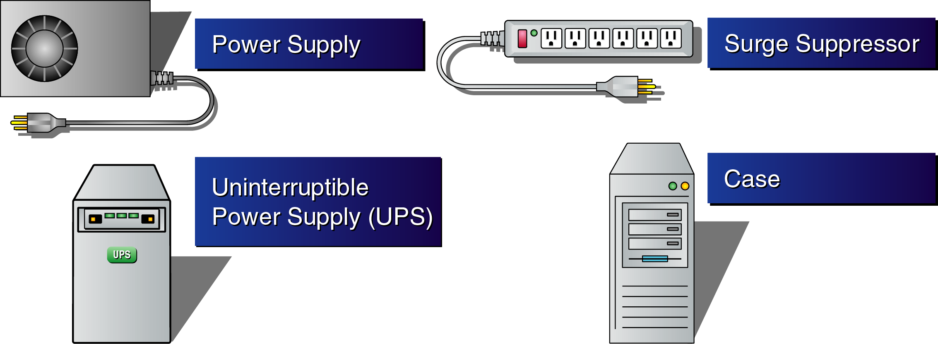
Support Hardware

Slide 7
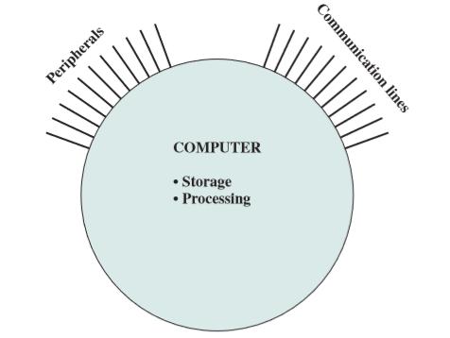
Struktur utama Sistem Komputer

Slide 8
Structure - Top Level
Peripherals
Computer
Central
Processing
Unit
Main
Memory
Computer
Systems
Interconnection
Input
Output
Communication
lines

Slide 9
Structure - The CPU
CPU
Computer
Arithmetic
and
Logic Unit
I/O
Registers
System
Bus
CPU
Internal CPU
Interconnection
Memory
Control
Unit

Slide 10
Structure - The Control Unit
Control Unit
CPU
ALU
Sequencing
Logic
Internal
Bus
Control
Unit
Control Unit
Registers and
Decoders
Registers
Control
Memory

Slide 11
Arsitektur Dasar Sistem Komputer
CPU
Memori
Program
Data
Von Neuman
Program dan Data terletak pada ruang fisik memori yang sama, sehingga akses harus bergiliran
I/O

Slide 12

CPU
Memori
Program
Harvard
Program dan Data terletak pada ruang fisik memori yang terpisah, memungkinkan pengaksesan secara paralel
Memori
Data
I/O

Slide 13
History of Computer
https://www.computerhistory.org/revolution
http://www.computinghistory.org.uk/cgi/computing-timeline.pl
http://content.time.com/time/photogallery/0,29307,1670168,00.html

Slide 14
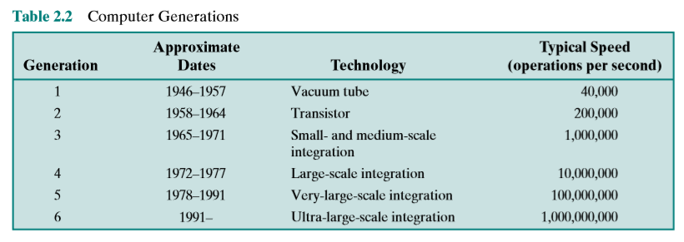
Computer history

Slide 15
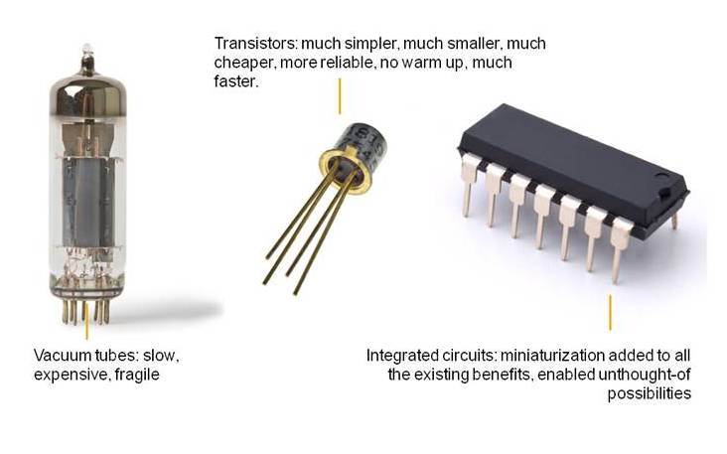
Computer history
Generasi pertama : Tabung hampa
ENIAC, EDVAC, UNIVAC
Generasi kedua : Transistor
IBM 7094
Generasi ketiga : Integrated Circuit (IC)
IBM SYSTEM/360, PDP-8
Generasi keempat : Microprosesor
Intel 8080
https://www.computerhistory.org/revolution

Slide 16
Moore’s Law
the number of transistors on an affordable CPU would double every 18 months

Slide 17
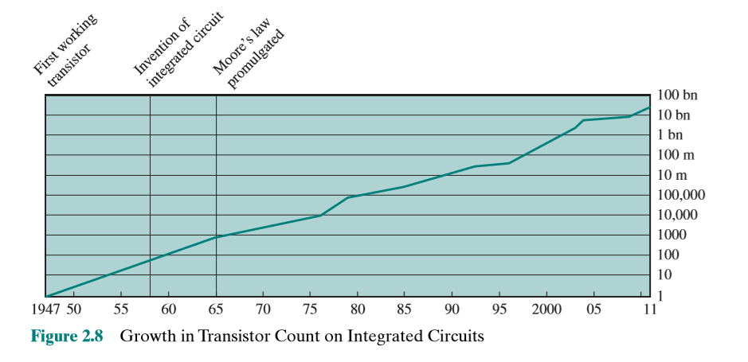

Slide 18
Review sistem bilangan
Bilangan biner
Bilangan desimal
Bilangan oktal
Bilangan hexadesimal

Slide 19
Kilo vs Mega vs Giga vs Tera

Slide 20
Bit vs Byte.

Slide 21
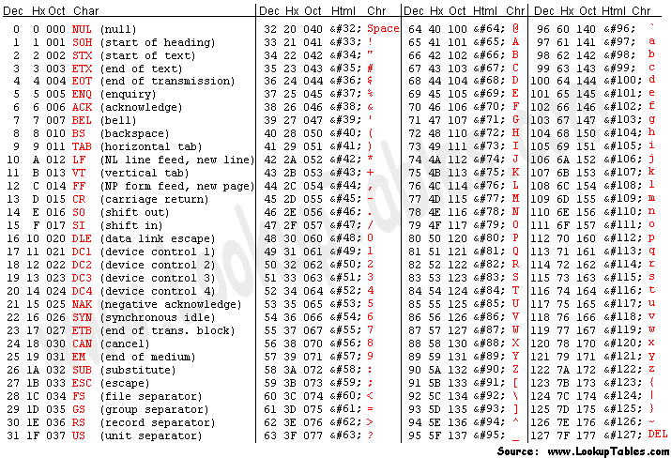
Merepresentaikan teks dengan bilangan biner

Slide 22
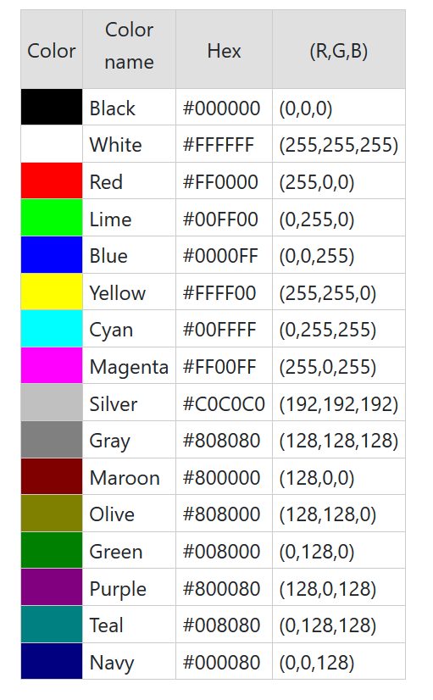
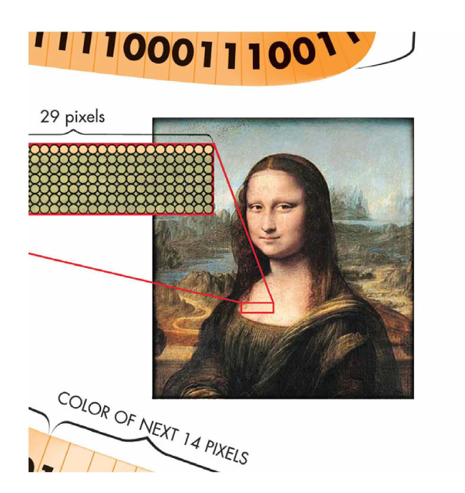
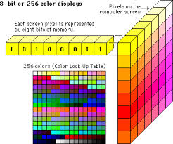
Gambar→ Pixel → Color Scheme→ Hexadecimal

Slide 23
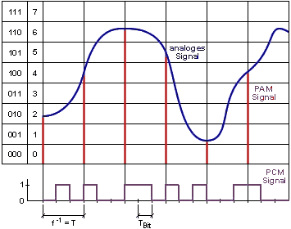
Voice → Digitize → Binary

Slide 24
Power supply

Slide 25
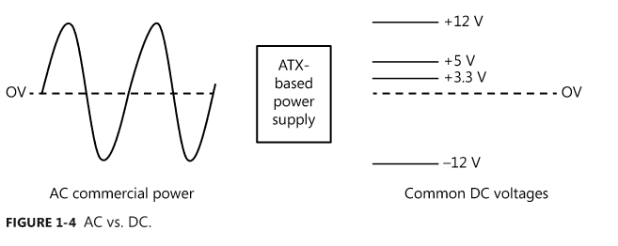
Voltage AC vs DC

Slide 26
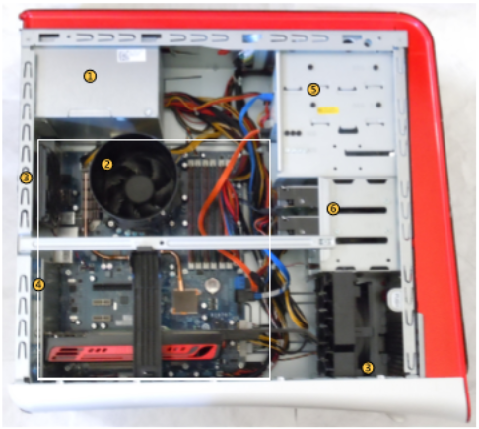
Power supply.
CPU fan
Case fans
Motherboard
Optical drive
Hard disk drive

Slide 27
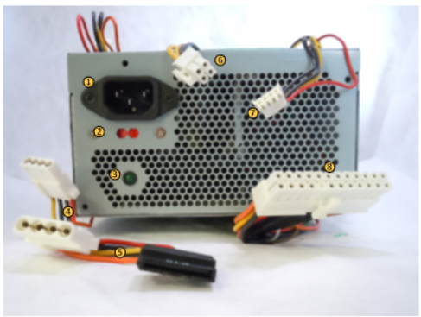
AC power jack
Dual voltage power selection
Power indicator
Molex connectors.
Sata power connector
Secondary motherboard power connection
Floppy drive mini-connectors
Primary power connector

Slide 28
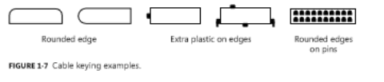
Cable Keying

Slide 29
Check it out
How Computer Works halaman 222 - 227

Slide 30
Kegunaan UPS

Slide 31
Pentingnya Ground

